Slide 1
Office 365 development
Speaker name

Slide 2
Deep Dive into Office Word Add-ins
</>

Slide 3
Agenda
Introduction to Word Add-ins
Developing Word Add-ins
Reading and writing with documents
Document Bindings
Packaging and deployment
Changes with Word 2016

Slide 4
Developer vision
USERS
DATA
HTML

Slide 5
1
Introduction to Word Add-ins

Slide 6
Web application loaded inside an Office application
Embedded inline or as task pane within documents, mails or appointments
Works in Office applications such as Microsoft Outlook
Works in Office Web applications such as OWA
Works in mobile Office clients
Office application extensions using Web technologies
HTML 5 and CSS used to construct user interface
JavaScript and jQuery used to add executable logic and event handlers
Add-in can provided code to read/write content to/from Office documents
Add-in can call Web services hosted over Internet or running within local network
What is an Office Add-in?
http://dev.office.com/
Notes:
An Office Add-in can be seen as a Web page loaded inside an Office Application. In some cases it will appear embedded inline within the document. In other cases it might appear as a task pane or within a message in Outlook. Note that the architecture for Office Add-ins has been designed to work in both Office Applications and Office Web Applications.
Office Add-ins allow Office applications to be extended in such as way so that they can leverage Web technologies such as HTML 5 and CSS for rendering user interface as well as JavaScript and jQuery to add behavior. When you write the JavaScript code for an Office Add-in, you can call REST APIs such as those added to SharePoint 2013 to retrieve and update data from across network.

Slide 7



Designing Office Add-ins—shapes
Office Add-ins come in different shapes
Word application
Excel application
Outlook application
Outlook application
Task pane Add-in
Content Add-in
Mail Add-in
Mail compose Add-in
Notes:
When you begin to design an Add-in, you must pick one of the three different shapes. You can create a document-based Add-in as either a Task Pane Add-in or a Content Add-in. Alternatively, you can create a Mail Add-in that targets Outlook and Outlook OWA.

Slide 8
Anatomy of an Office Add-in
Each Office Add-in is based on XML-based manifest
Manifest points to a Web page
Manifest defines the type of the Office Add-in
Manifest defines which Office applications it supports
Manifest defines required capabilities
Office Add-in
Office Add-in manifest
<XML>
Web page
HTML + JS
Notes:
Every Add-in for Office must be distributed with an XML-based manifest which contains information about the Add-in itself. For example, the Add-in manifest contains an address to a Web page on the Internet which is used to load the Add-in. The Add-in manifest also includes information which indicates which Office applications it supports. The Add-in manifest also defines the required capabilities which represent the set of permissions that the Add-in needs in order to run and complete its work.

Slide 9
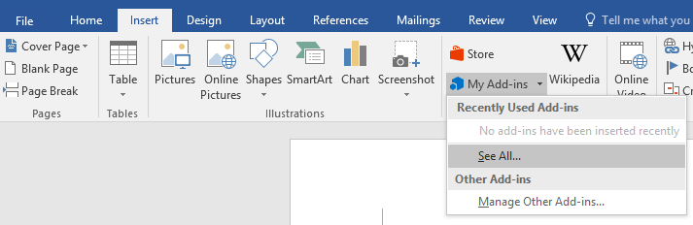
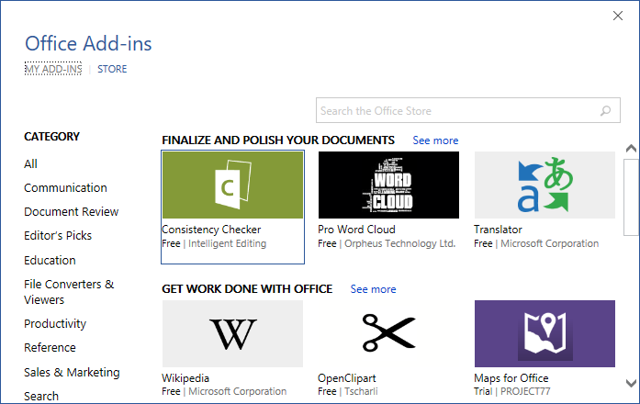
Adding an Office Add-in using the insertion UI
Office Add-in insertion UI located in ribbon inside insert tab
Dialog allows you to add and start Office Add-in
http://dev.office.com/
Notes:
Office 2016 applications provide users with the ability to discover add-ins and insert them. In Word and Excel, this support is included in the Ribbon inside the Insert Tab.
When you drop down the Add-ins menu from the ribbon, you can see recently selected add-ins. If you click "See All", you will be prompted with a dialog that allows you to look in various Add-in directories. Once you find an add-in you want to use, you can click the Start button to insert the Add-in into the current document and start it up. After this, you can save the current document which will then include the add-in.

Slide 10
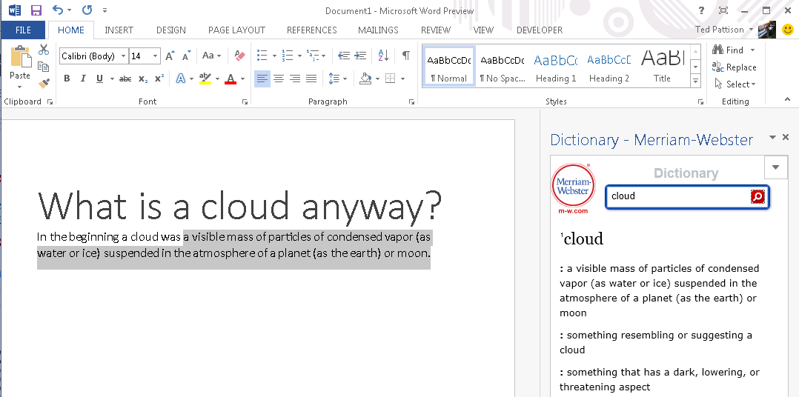
Task pane Add-in user experience
Familiar user experience
Leverages familiar Office UI paradigm
Reference information
Ideal for providing reference information associated with document
http://dev.office.com/
Notes:
One reason to create a task pane add-in is that it provides Office users with a familiar user experience. For example Microsoft Word and Microsoft Excel have exposed many of its internal features using task panes so task pane add-ins provides a familiar Office UI paradigm.
Task pane add-ins are ideal for providing users with reference information. For example, a task pane add-in can perform Internet searches or lockups and provide reference information that can be inserted back into the current document.
This slide contains a screenshot showing the add-in after it has been inserted in a document. In Microsoft Word 2016. Different add-ins provide different user experiences. This add-in which is available for free on the Office Store allows the user to leverage the Marriam-Webster online dictionary lookup service to look up words and terms right from within Microsoft Word.

Slide 11
2
Developing Word Add-in

Slide 12
1
Create new Add-in for Office project
Create/design user interface for Web page
Enhance Web page with CSS and JavaScript
Set project properties in manifest
Run!
2
Visual Studio experience
3
4
5
http://dev.office.com/
Notes:
This slide is pretty self-explanatory and demonstrates just how easy it is to create and test your first Office Add-in using Visual Studio. First, you will create a new project using one of the project templates in Visual Studio. Next, you will create the user interface for the Add-in using HTML5 and CSS. After that, you add behavior to the add-in by writing JavaScript. Finally, you will update the XML file which serves as the add-in manifest. After that, you can press the {F5} key to test and debug your add-in.

Slide 13
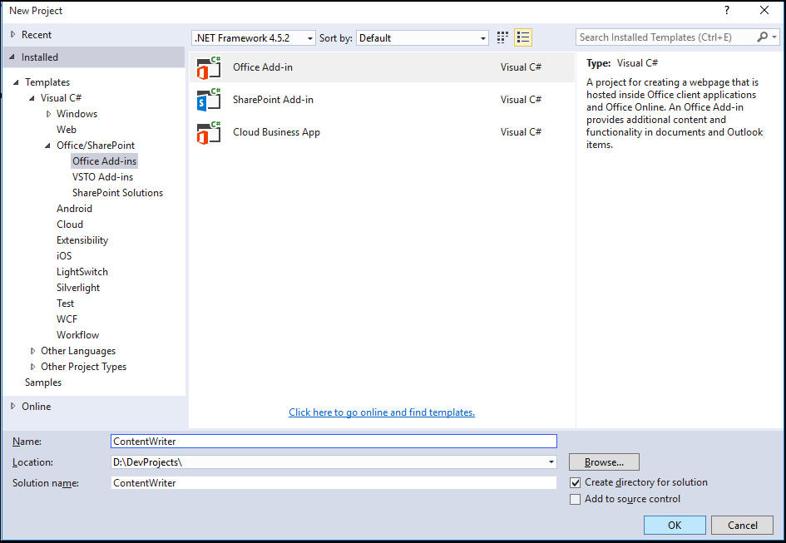
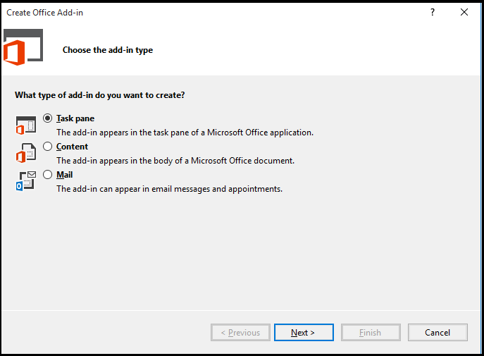
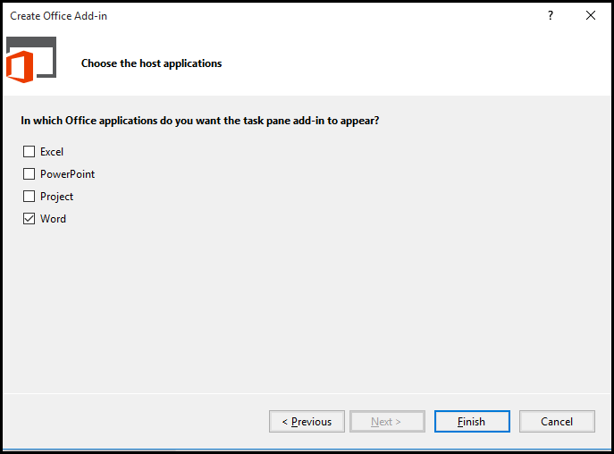
Create new Office Add-in
Create project based on Add-in for Office project template
Dialogs appear and prompt you for specifics about the Add-in
You must choose (1) the Add-in shape and (2) which Office application are to be supported
Notes:
Visual Studio has a project template for Office Add-ins. These project types gives you a starter project with a web page and manifest.

Slide 14
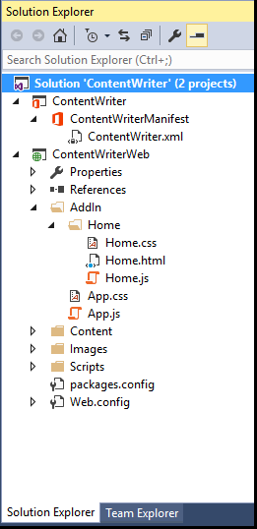
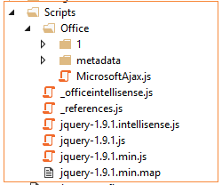
Office Add-in project structure
Office Add-in solution has two projects
Top project contains Add-in manifest
Bottom project for remote Web
Remote Web project is ASP.NET website
Contains HTML, CSS, and JavaScript source files
Integration with jQuery library already included
http://dev.office.com/
Notes:
The slide shows the initial structure of a task pane add-in created with the Visual Studio.

Slide 15
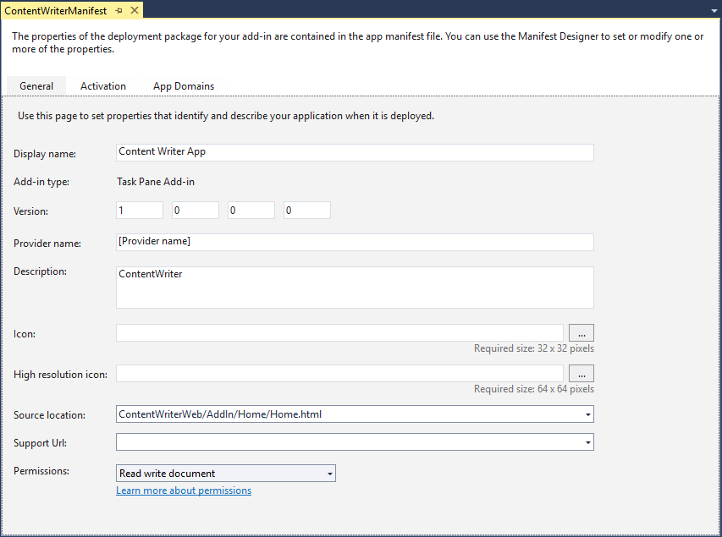
Add-in manifest designer
Notes:
This slide shows the Visual Studio designer for an Add-in manifest in a task pane Add-in. It will look different for other types of Office Add-in.

Slide 16
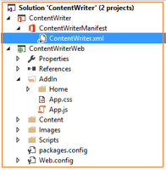
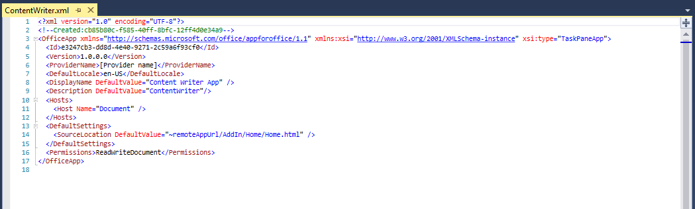
Add-in manifest—XML view
Notes:
There are times when it is also useful or necessary to examine or update the manifest in XML view. You can enter XML view by clicking the XML file in the Solution Explorer.

Slide 17
Create the HTML for Web page
<!DOCTYPE html>
<html>
<head>
<meta charset="UTF-8" />
<meta http-equiv="X-UA-Compatible" content="IE=Edge" />
<title></title>
<script src="../../Scripts/jquery-1.9.1.js" type="text/javascript"></script>
<link href="../../Content/Office.css" rel="stylesheet" type="text/css" />
<script src="https://appsforoffice.microsoft.com/lib/1/hosted/office.js" type="text/javascript"></script>
<link href="../App.css" rel="stylesheet" type="text/css" />
<script src="../App.js" type="text/javascript"></script>
<link href="Home.css" rel="stylesheet" type="text/css" />
<script src="Home.js" type="text/javascript"></script>
</head>
<body>
<div id="content-header">
<div class="padding">
<h1>Add Content to Document</h1>
</div>
</div>
<div id="content-main">
<div class="padding">
<div>
<button id="addContentHellowWorld">Hello World</button>
</div>
</div>
</div>
</body>
</html>
Notes:
Each add-in has a source location which points to a entry point Web page somewhere on the Internet. Here is an example of a simple Web page that is used to load a task pane add-in. Note that this page must link to any required CSS files and JavaScript that will be adding styles or behavior behind the add-in. Visual Studio automatically adds the links for jQuery and ASP.NET AJAX. Also note that the page adds HTML elements which are often created with ids and/or classes.

Slide 18
Navigation and links
Dos
Provide hyperlinks to open in browser
Design Add-in to fit on one host page
Use iFrame with navigation bar if absolutely necessary
Consider ways to provide messages to users
Don’ts
Expect hyperlinks to open in Add-in window (blocked)
Send users to trapped pages via poor navigation trails
Use alerts
http://dev.office.com/
Notes:
This slides discusses what to use and what to avoid when designing an add-in.
Do provide hyperlinks within an to open Web pages in a new browser window. This makes it easier to design an Add-in that fits cleanly on a single host page. Within the host page you can also use an iFrame to host content and provide a navigation bar if needed to change the contents of the iFrame using JavaScript. Also consider how your add-in will provide informational messages to the user. Typically this is done by adding a HTML element such as a div to the host page and dynamically writing text inside using JavaScript.
Here is a list of design issues to avoid. When creating hyperlinks, do not use <a> tags without a target attribute to open the link in a new window browser. You will find that such links are blocked by the Office UI if they attempt to take the user to a different domain. Also avoid links which navigate the user to pages which do not allow them to return to the start page as there is nothing similar to the back button inside the browser. Also, avoid interaction with the user using the poor man's technique of using the JavaScript alert function which has more restrictions inside an add-in than it does when used inside a browser.

Slide 19
Full control of what is inside the Office Add-in
Developer can override the right-click context menu
No control to customize the Add-in container menus
Developer cannot customize task pane or content/chart object menu
Ability to save settings to “property bag”
Property bag values saved with the Add-in within the document
With Mail Office add-ins property bag values save within Exchange
Context menus and settings controls
http://dev.office.com/
Notes:
If you want an add-in to provide custom menus to the user, you should understand that you have control only of the users interface inside the add-in but not any UI elements outside. You can override the add-in context menu that appears at the upper right-hand corner of an add-in. However, when creating an add-in you have no control over customizing any other menus within Office add-ins.
Also remember that you have the ability to save custom properties as name values pairs using the settings API. These names value pairs are saved within the current document with task pane add-ins and with content add-ins. With mail add-ins these property values are saved within Exchange along with the host message or appointment.

Slide 20
var app = (function () {
"use strict";
var app = {};
// Common initialization function (to be called from each page)
app.initialize = function () {
$('body').append(
'<div id="notification-message">' +
'<div class="padding">' +
'<div id="notification-message-close"></div>' +
'<div id="notification-message-header"></div>' +
'<div id="notification-message-body"></div>' +
'</div>' +
'</div>');
$('#notification-message-close').click(function () {
$('#notification-message').hide();
});
// After initialization, expose a common notification function
app.showNotification = function (header, text) {
$('#notification-message-header').text(header);
$('#notification-message-body').text(text);
$('#notification-message').slideDown('fast');
};
};
return app;
})();
Code added by Visual Studio
http://dev.office.com/
Notes:
JavaScript is the language that is used to add executable code and behavior to an Office Add-in. The JavaScript you write for an add-in will typically take advantage of the various JavaScript APIs supplied for Office.js and other JavaScript library files for specific Office applications such as Word, Excel and Outlook. In addition to the Office JavaScript APIs, the JavaScript code you write for an Office Add-in can also take advantage of the ASP.NET AJAX library as well as jQuery.
The Office JavaScript API provide a top-level named Office which provides an initialize function. By overriding this function as shown in the code above, you can write code that will automatically execute as the end of the initialization process when an add-in is started. A common approach is to register a jQuery document ready event handler inside this function.

Slide 21
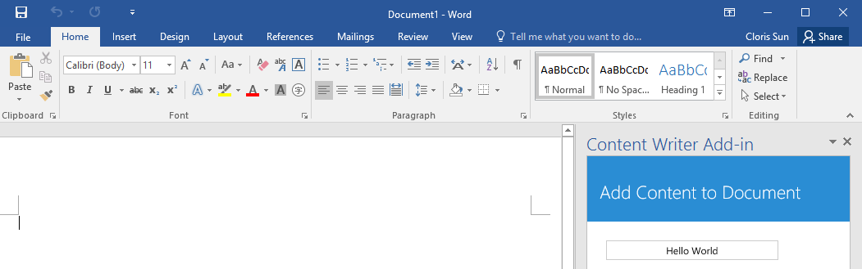
Test/debug the Office Add-in using {F5}
When you press the {F5} key…
Visual Studio builds the Add-in package and temporarily registers it
Visual Studio starts Microsoft Word and adds the Add-in to new Word document
http://dev.office.com/
Notes:
When you press the {F5} with a Visual Studio project for an task pane add-in or a content add-in, Visual Studio automatically adds a registry entry to allow Office applications such as Word and Excel to discover the add-in which makes it possible to add it to a document.

Slide 22
Demo Creating an Office Add-in targeting Microsoft Word

Slide 23
3
Reading and writing with Documents

Slide 24
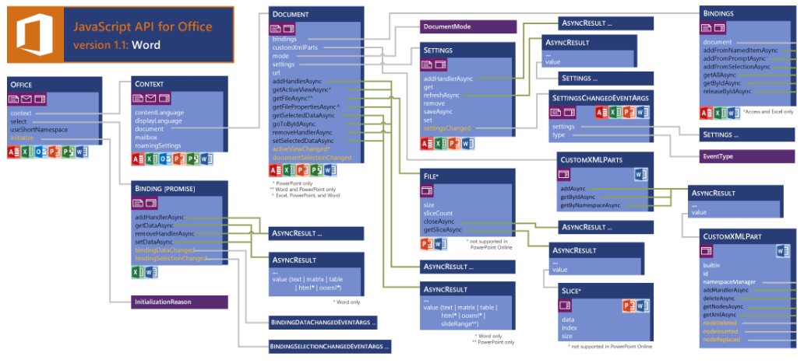
JavaScript API for Word Add-ins
See more at: http://msdn.microsoft.com/en-us/library/office/fp142185(v=office.1501401).aspx

Slide 25
getSelectedDataAsync()
Use this function to read from document select
function getDataFromSelection() {
Office.context.document.getSelectedDataAsync( Office.CoercionType.Text,
function (result) {
if (result.status == Office.AsyncResultStatus.Succeeded) {
app.showNotification('The selected text is:', '"' +
result.value + '""');
} else {
app.showNotification('Error:' + result.error.message);
}
});
}
Notes:
The function getSelectedDataAsync() is used to read content from the selected region of the current Word document.

Slide 26
setSelectDataAsync()
Use this function to insert content into document
function onAddContentHellowWorld() {
Office.context.document.setSelectedDataAsync("Hello World!",
testForSuccess);
}
function testForSuccess(asyncResult) {
if (asyncResult.status === Office.AsyncResultStatus.Failed) {
app.showNotification('Error', asyncResult.error.message);
}
}
Notes:
The function setSelectedDataAsync is used to write content into the selected region of the current document. If there is no selected region, the content is added at the location of the cursor.

Slide 27
Coercion types
function onAddContentHtml() {
var div = $("<div>")
.append($("<h2>").text("My Heading"))
.append($("<p>").text("This is paragraph 1"))
.append($("<p>").text("This is paragraph 2"))
Office.context.document.setSelectedDataAsync(div.html(), { coercionType: "html" }, testForSuccess);
}
function onAddContentMatrix() {
var matrix = [["First Name", "Last Name"], ["Bob", "White"], ["Anna", "Conda"], ["Max", "Headroom"]];
Office.context.document.setSelectedDataAsync(matrix, { coercionType: "matrix" }, testForSuccess);
}
function onAddContentOfficeTable() {
var myTable = new Office.TableData();
myTable.headers = [['First Name', 'Last Name']];
myTable.rows = [['Bob', 'White'], ['Anna', 'Conda'], ['Max', 'Headroom']];
Office.context.document.setSelectedDataAsync(myTable, { coercionType: "table" }, testForSuccess)
}
Coercion types make it possible to read/write content in different formats
text—string value
html—HTML content
matrix—array of arrays
table—table of rows and columns
ooxml—Office Open XML format
http://dev.office.com/

Slide 28
Demo Writing content to the selected region of a Word Document

Slide 29
4
Document Bindings

Slide 30
Word supports data binding to content in document
Word currently only supports binding with Rich Text Content Control
Bindings created using Content Control title which serves as ID
You can read and write bound content regardless of where selected region is
You can register event handlers to fire when user updates bound content
Bindings in Office Word Add-in
http://dev.office.com/
Notes:
Bindings are import because they make it so you can read and write to specific areas in a Word document without having to worry about what the selected region is

Slide 31
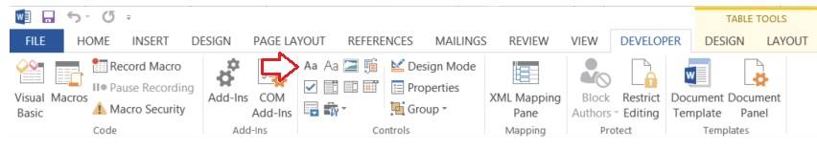
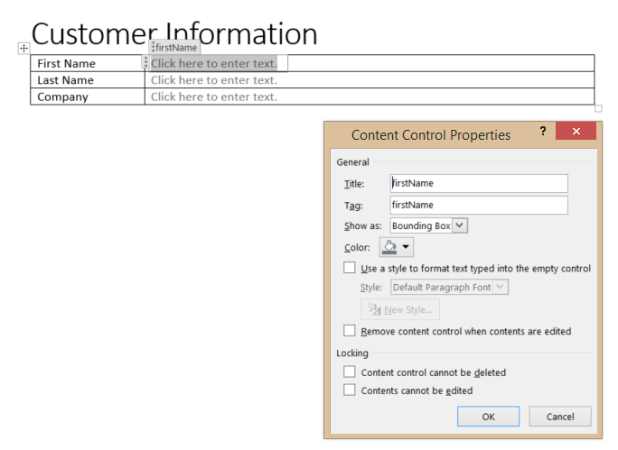
Adding Content Controls
Add Rich Text Content Control from Developer tab
Modify Content Control Title property to assign ID for binding
http://dev.office.com/
Notes:
Bindings are import because they make it so you can read and write to specific areas in a Word document without having to worry about what the selected region is

Slide 32
Adding bindings in JavaScript
function onCreateBindings() {
Office.context.document.bindings.addFromNamedItemAsync("firstName", "text", { id: 'firstName' },
onBindingsCreated);
Office.context.document.bindings.addFromNamedItemAsync("lastName", "text", { id: 'lastName' },
onBindingsCreated);
Office.context.document.bindings.addFromNamedItemAsync("company", "text", { id: 'company' },
onBindingsCreated);
}
function onBindingsCreated(asyncResult) {
if (asyncResult.status == Office.AsyncResultStatus.Succeeded) {
app.showNotification('Added new binding with type: ' + asyncResult.value.type + ' and id: ' +
asyncResult.value.id);
}
else {
app.showNotification('Error', asyncResult.error.message);
}
}
function onSetBindingValues() {
Office.select("bindings#firstName", testForSuccess).setDataAsync("Bob", testForSuccess);
Office.select("bindings#lastName", testForSuccess).setDataAsync("Barker", testForSuccess);
Office.select("bindings#company", testForSuccess).setDataAsync("Price is Right", testForSuccess);
}
Notes:
The top code listing shows how to create bindings in JavaScript code using addFromNamedItemAsync. Note that the first parameter (e.g. "firstName") is used to indicate which content control you want to bind to. The third argument (e.g. { id: 'firstName' } is used to create the binding ID that will be used to retrieve the binding when call the Office.select function.
Note that the call to Office.select gets the binding using a syntax of "bindings#" followed by the ID of a registered binding.

Slide 33
Adding event handler bindings
Event handlers added using addHandlerAsync()
Callback function called automatically when user updates binding content
function onRegisterBindingEventHandlers() {
Office.select("bindings#firstName", testForSuccess).addHandlerAsync(Office.EventType.BindingDataChanged,
onBindingDataChanged, testForSuccess);
Office.select("bindings#lastName", testForSuccess).addHandlerAsync(Office.EventType.BindingDataChanged,
onBindingDataChanged, testForSuccess);
Office.select("bindings#company", testForSuccess).addHandlerAsync(Office.EventType.BindingDataChanged,
onBindingDataChanged, testForSuccess);
}
function onBindingDataChanged(eventArgs) {
app.showNotification('Binding with id of ' + eventArgs.binding.id + ' was updated!');
}
Notes:
This code shows how to register an event handler on a binding using the addHandlerAsync function.
The call also registers a callback function named onBindingDataChanged which is called automatically when user updates the bound content.

Slide 34
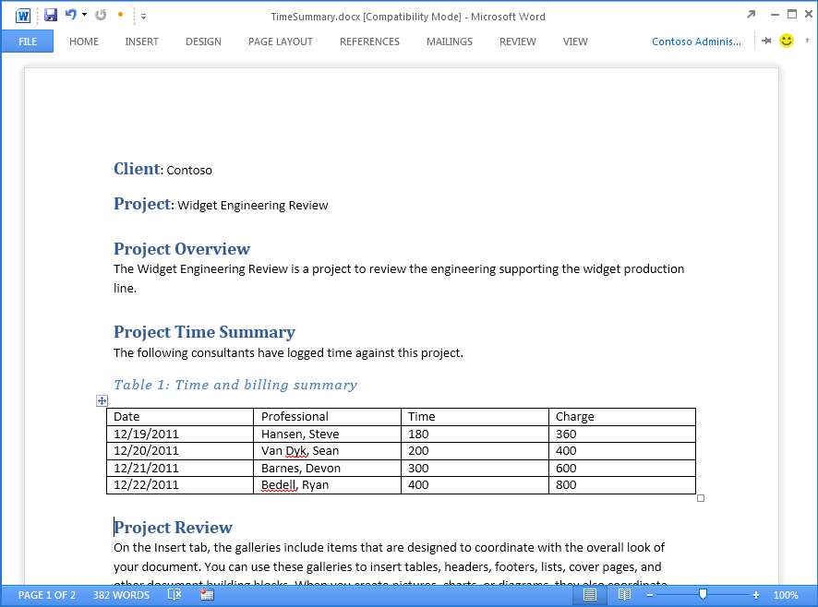
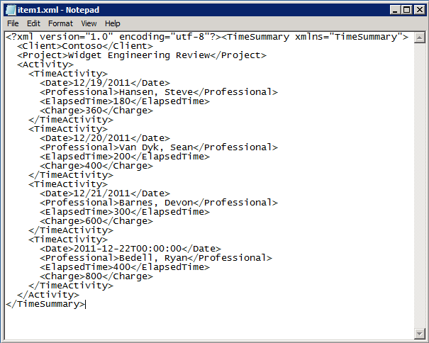
Open XML and Content Control refresher
The TimeSummary document contains custom XML document
Inner XML document contains elements bound to Word Content Controls
Custom XML document can be modified/updated by your Add-in
Custom XML document can be modified by user input
WORD FILE STRUCTURE
Content Controls mapped to custom XML part
_rels
customXml
docProps
word
Content
Notes:
Microsoft Word introduced Content Controls in Office 2007. Content controls act as containers and user input controls for specific kinds of content. A valuable role of content controls is that they can be mapped to nodes within a custom XML part which is an XML document with custom content which is embedded within a Office document such as a DOCX file..
With Office 2016, there is a new content control for repeating sections. A Repeating Section content control provides the capability to bind to a collection of nodes which typically represent the many side on a one-to-many relationship as in the case where a single time summary document has many time activity entries.

Slide 35
5
Packaging and deployment

Slide 36
Steps
Deploy the remote Web-to-Windows Azure or to other Web server
Build Add-in package which must include HTTPS URL of remote Web
Upload add-in package to Add-in catalog
Choosing An Add-in Catalog
SharePoint Add-in catalog is preferred because it offers several advantages
File Share Add-in catalog deployment is a simpler, less-powerful option
Office Add-in deployment
http://dev.office.com/
Notes:
When it is time to deploy an add-in, the actual deployment is similar to standard web site because you must make the Web page for an Add-in and the office supporting files available on a Web server. However, you must also publish the manifest to make the Add-in discoverable for installation. IT admins can designate trusted Add-in Catalogs via Global Policy Objects (GPO). Note that the manifests for Mail Add-ins must be uploaded to Exchange 2016 Add-in Catalog.

Slide 37
Designed for private corporate networks
Provides users with catalog of pre-screened and pre-approved Add-ins
Often used to deploy Add-ins developed in-house of by 3rd-party ISV
Supports document-based Add-ins (e.g., task pane Add-ins and content Add-ins)
SharePoint Add-in catalog hosted using Site Collection
Actual catalog is document library containing Add-in manifests
Administrator can configure Add-in for Office security settings
SharePoint Add-in catalog
http://dev.office.com/
Notes:
SharePoint 2013 implements the Add-in Catalog using a site collection created from a special site template. The Add-in Catalog is designed for Office 365 and for private corporate networks in that it is available to only to users who have been granted access. It provides users with catalog of pre-screened and pre-approved Add-ins. An Add-in Catalog can be used to deploy add-ins developed in-house of by 3rd party ISVs. Note that the Add-in Catalog in SharePoint supports document-based Add-ins (i.e. Task pane Add-ins and Content Add-ins).
As already mentioned, the SharePoint Add-in Catalog hosted using a SharePoint 2013 site collection. The actual catalog is simply a document library to which Add-in manifests are uploaded. The administrator can configure Add-in security settings that controls who can see and install the Add-ins inside.

Slide 38
Provides simplest means to deploy Office Add-ins
Does not require either SharePoint or Exchange
Office Add-ins manifests copied to Windows File Share
Office applications configured to read File Share to discover Office Add-ins
Client machine requires registry entry with File Share path
File Share Add-in catalog
http://dev.office.com/
Notes:
A File Share Add-in Catalog provides the easiest way to deploy Office Add-ins. It does not require either SharePoint 2013 or Exchange 2016. Instead, Add-in manifest are simply copied to a Windows file share. Of course, the user desktops running Office Applications must be configured with the correct file share path to discover Office Add-ins which can be done manually by user or centrally using GPO.

Slide 39
6
Changes to Word 2016
Microsoft Confidential
http://dev.office.com/

Slide 40
Original Office.js release was very async focused
Challenging to do batch operations
Very transactional to interact with a document
New API more similar to the SharePoint CSOM
Office.js API Changes
http://dev.office.com/

Slide 41
RequestContext()
All actions that target a Word document start by getting reference to the word context:
var context = new Word.RequestContext();
Contains queue of commands to be performed on doc
Bridge between Office add-in and Word application
Execute operations in batches
</>
Notes:
All actions that target a Word document start by using the client request context returned by the Word.RequestContext method. The client request context serves two major roles:
Contains the queue of commands that will be performed on the contents of a Word document.
Provide the bridge between the Office add-in and the Word application since they run in two different processes. The JavaScript runs in the user's browser within the task pane. Word runs in a different process, and in the case of Word Online, on a remote server cluster.

Slide 42
sync()
Submits request queue to Word via the context
Returns promise object
var context = new Word.RequestContext();
Word.run(function (context) {
var range = context.document.getSelection();
range.insertText("Hello World!", Word.InsertLocation.end);
return context.sync().then(function () {
console.log("Done");
})
}).catch(function (error) {
console.log('Error: ' + JSON.stringify(error));
if (error instanceof OfficeExtension.Error) {
console.log('Debug info: ' + JSON.stringify(error.debugInfo));
}
});
Notes:
The Word JavaScript objects created in the add-ins are local proxy objects. Invoking methods and setting properties queues the set of commands in JavaScript, but does not submit them until sync() is called. sync submits the request queue to Word and returns a promise object, which can be used for chaining further commands. sync runs each command in the order in which they were added to the queue. A best practice is to group related commands into a single sync call.

Slide 43
load()
Specifies what collections, objects, and properties are loaded into the object
ctx.load(object, loadOptions);
// or
object.load(loadOptions)
Notes:
The load method specifies which collections, objects, and properties will be loaded into the object model. You use the client request context to specify the load options and the object to load. There are two options for using the load method.

Slide 44
loadOption Object
Specifies which properties to load and how to page through collections
Select: specify properties you want to collect
text, style, font
Expand: load properties nested Word API objects and collections
font/color, paragraphs/text
Top: select only the first N number of items in the collection
Skip: skip the first N number of items in the collection
Notes:
You use the select option to load properties that are primitive types. You can use either a string or an object literal to specify which properties to load. For example, if you are going to make simple load statement, you don't need to create an object literal to specify the property.
You use the expand option to load properties that are in nested Word API objects and collections. Using the range object from the previous examples, we can load the paragraphCollection and the font object for the range by specifying the objects in the expand option. We identify which properties are returned in the select statement.

Slide 45
Demo Exploring OfficeJS in Word 2016
Microsoft Confidential
http://dev.office.com/

Slide 46
Related documentation
MSDN: create a task pane Add-in with Napa Office 365 Development Tools
https://msdn.microsoft.com/EN-US/library/office/jj554660.aspx
MSDN: Word Add-ins
https://msdn.microsoft.com/EN-US/library/office/dn833112.aspx
JavaScript API for Office
https://msdn.microsoft.com/en-us/library/fp142185.aspx
Microsoft Confidential
http://dev.office.com/

Slide 47
Related code samples
Office Add-in Samples
http://dev.office.com/codesamples#?filters=office%20add-ins
Microsoft Confidential
http://dev.office.com/

Slide 48
Summary
Introduction to Word Add-ins
Developing Word Add-ins
Reading and writing with documents
Document Bindings
Packaging and deployment
Changes with Word 2016

Slide 49
Developer Program launch
1 YEAR FREE
Email newsletters
Free Developer subscription
Free training
Free tools
Webinars
http://dev.office.com/devprogram

Slide 50
Engage

